Slide 1
Encinal Jets-ons Robotics
Prepare yourself for a tour of epicness!!

Slide 2
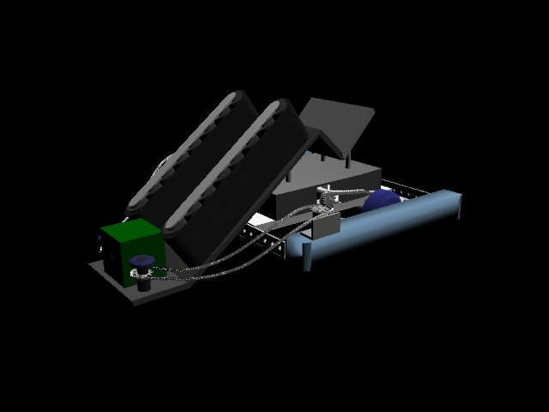
Introduction – The Conveyor Belt
Strategy:
Use a motor powered wheels on the ramp to pull the boxes into the robot
Utilize 2 conveyor belts to transport the boxes
Challenges:
Controlling motor speeds on the ramp and conveyor belt
Capacity of the conveyor belt
Keeping the boxes inside the robot.

Slide 3
Mechanism
The conveyor belt is built on an aluminum frame to ensure stability, and it is powered by two motors.
Each conveyor belt is mounted sideways on one side of the ramp.
The belt itself is made out of rubber so it has enough traction ( so the boxes won’t fall off).
Two motors run in the opposite direction to pull the boxes up the ramp.
The ramp/ track is made of a polycarbonate sheet for the least amount of friction.

Slide 4
Obstacles
The boxes may slide off the ramp
The opponent might run into our robot and knock the boxes out
Solution: Build a polycarbonate cover on top
Controlling the speed of the wheels on the ramp and the conveyor belt
Solution: Put in larger sprocket for the belt’s motor to speed up.
Capacity of the conveyor belt may be minimal
-Solution: We’re using a thick rubber material for the conveyor belt so we can fit as many boxes on it as possible.
We can’t be selective when it comes to choose which boxes to take (normal or multiplier boxes)
Solution: The speed of our robot allows us to drop off boxes when we don’t want them.

Slide 5
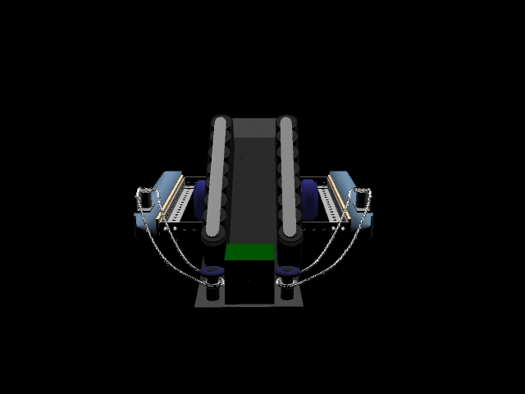
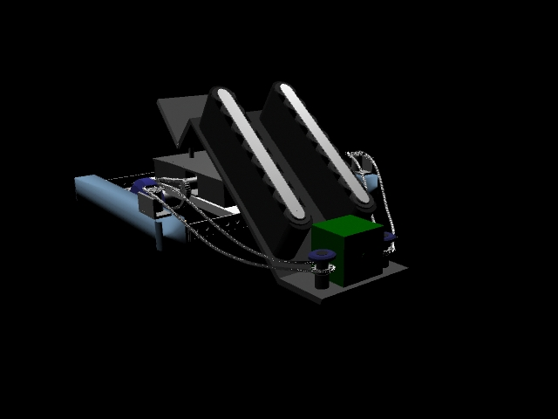
Testing
We will try to slide the ramp under the test box and bring the box all the way into the robot using the Conveyor belt.

Slide 6
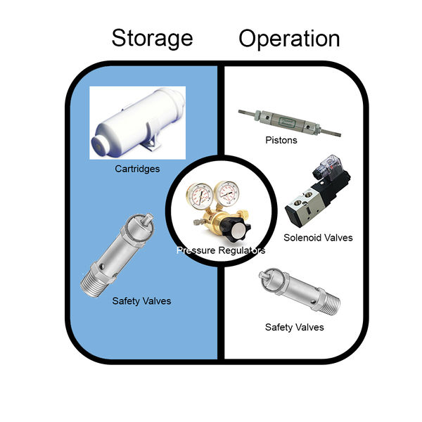
The Pneumatic
Strategy
Launch the boxes across the field to allies
Push the boxes towards the conveyor belt/ramp into goals
Challenges:
Timing the release
Expensive
Making room for it on the robot

Slide 7
Mechanism
Two pneumatics is going to be attached to the back end of the aluminum frame of the robot.
One will push the boxes from the end of the robot/conveyor belt to the direction opposite of the intake.
The other will launch the boxes from the end of the robot into the alliance’s goal. In doing so, we will need it to be positioned at a certain angle.
Both pneumatic devices need to be heavily pressured (possibly 105 psi – the max)
The pneumatic kits will be purchased from PiE.

Slide 8
Obstacles
Boxes are blocking the path
Solution: Use the pneumatic device of the robot to push them away
Timing the release
Solution: We will try to program the pneumatic so we can control the release with our Xbox 360 controller.
Expensive
-Solution: We will try to conserve our Panda Points and limit our expenses on other parts.
Making room for it on the robot
Solution: We will have to give up some of the conveyor belt’s length.
Depends more on the ally
Solution: We have multiple options for the pneumatic mechanism and one of them will allow us to be independent of allies.

Slide 9
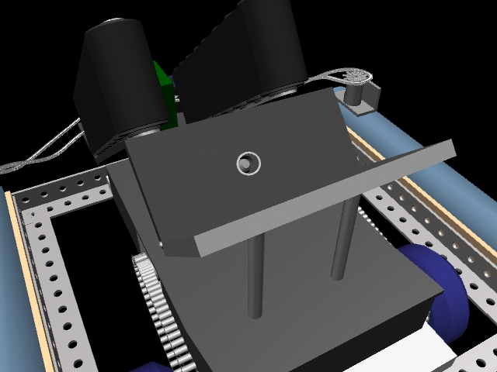
Testing
We will attempt to launch test boxes from the end of the robot to either the goal or the alliance’s goal.

Slide 10
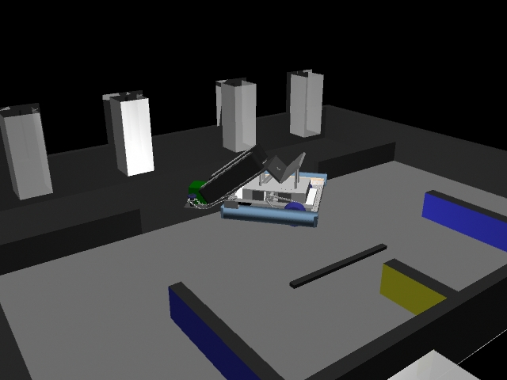
General Obstacles
Bumps and ridges
Solution: Manipulate robot's speed when passing through bumps
The robot is too big
Solution: Have the ramp and other mechanisms be able to extend out and fold in.

Slide 11
Programming: Autonomous Code
We will make it so the robot will follow the white line by using reflective sensors
When the robot passes the line, we will make it so it goes back to the line.
When the robot gets close to a obstacle, we will make it slow down and change direction (away from the wall).
We will utilize PiECraft in order to test our code first on a simulated robot.

Slide 12
Programming: Teleoperated/User Controlled Code
Code in arcade style (one analog stick on the X box360 controller moves the whole robot left,right, forward, and backward).
The other analog stick will control the speed and direction of the conveyor belt.
The LMB and RMB will control the wheels on the ramp.
A will activate the first pneumatic device and B will activate the second.

Slide 13
Backup Plan
Because of our robot’s versatility, we are able to take out certain parts like the pneumatic device and still have a functional robot.
If we take out the pneumatic devices, the conveyor belt can still carry the boxes into goals.
If we take out the conveyor belt, we can still have a robot that pushes out the boxes into goals.
Furthermore, there are simple replacements for the conveyor belt because of materials like the surgical tube available at PiE.

Slide 14
Important Materials and Costs
Pneumatic Kits x2.............$45.00 Each
-Motor Controllers x4.......$10.00 Each (2 Included in Kit)
-Motors x4 (Pololu 360 2g-1 w/out encoder)...$20 Each (2 Included in Kit)
-Servos $20
-Polycarbonate x2...........$2.00 Each
-Aluminum x3 $2
Total (including other items) : $ 235.5 (In Panda Points)

Slide 15
Measurements
The Box:
~614 Inchesx~614 Inchesx~614 Inches
***Each sensor juts out about 1cm, and is 1inch diameter.
The Robot Chassis:
1ft 5in 3/4 x (bumper sides) 1ft 4in 3/4
The motor attachment side:
2in. x 3in. (then bent 90*) 2in. x 3in.
The Wheel:
3 13/16th’s inches (Diameter)
3/4 in. (width)
The Conveyer Belt:(estimate)
24inches each*(11 for each side, 2 for both corners)
*If it is m

Slide 16
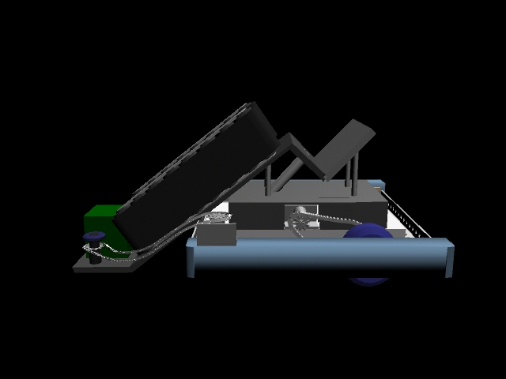
Advantages/Why our robot is the best
Our robot is very efficient and fast because of our mechanisms: the conveyor belts, ramp, and pneumatic devices.

